Slide 1


Purchase Requisition Process - Odoo ERP

Slide 2
General Overview
Whenever need for an item arises, the user will request items from the store through the use of planned transfer. If the item is available the stores personnel will validate the request and issue the item (s), if not a purchase request will be raised in odoo ERP to procure the item (s).
The purchase request will be sent to departmental manager for approval then forwarded to purchasing department to source from the suppliers and procure the item (s)

Slide 3
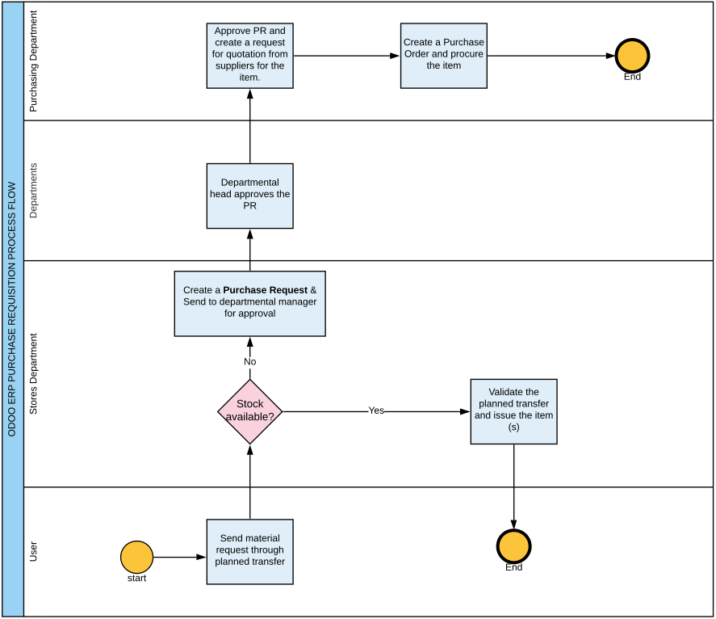

Slide 4
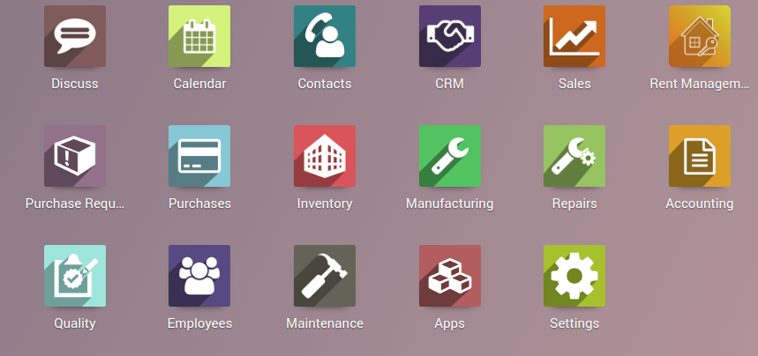
Purchase request creation
Log in to Odoo ERP and click the Purchase Request Module.

Slide 5
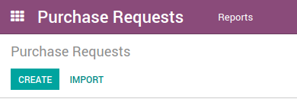
Click on create button

Slide 6
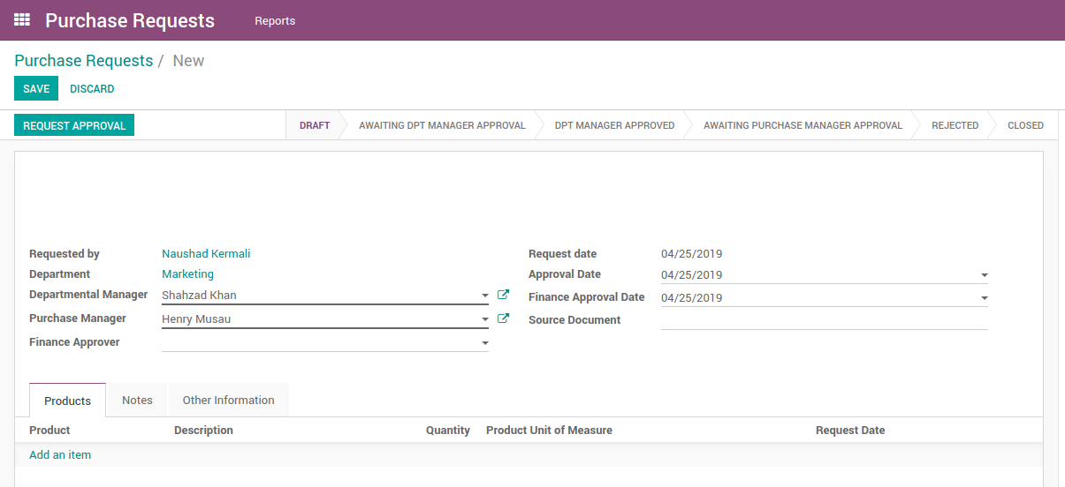
The header section will display user information. Click on ‘Add an item’ to request

Slide 7
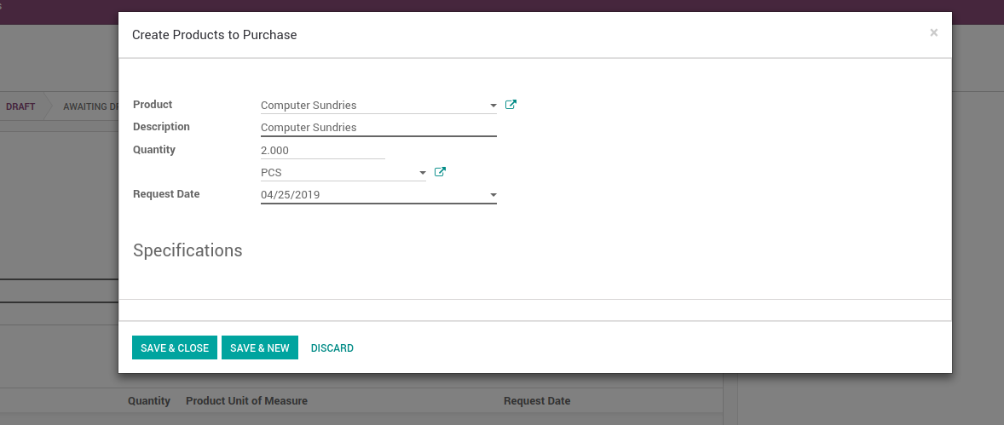
Select the name of the product and quantity to be procured. Click ‘Save & Close’ if that’s the only item to be requested or ‘Save & New’

Slide 8
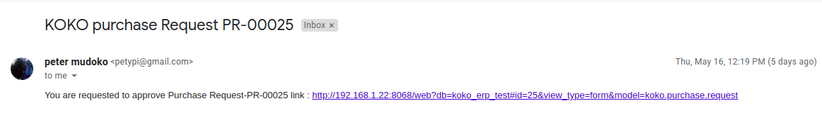
Approval Email to HOD
Once the Requestor is done, a notification mail will be sent to the HOD requesting him/her to approve

Slide 9
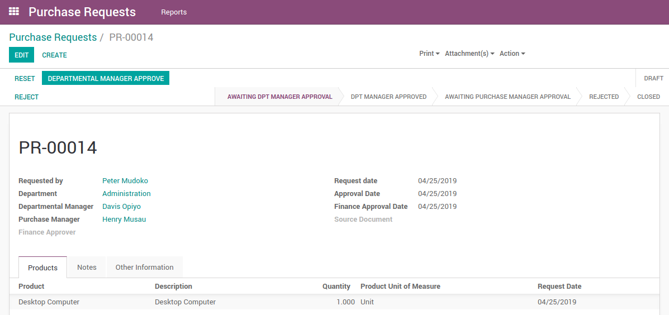
Departmental Manager Approval
Manager will login and click on ‘Departmental Manager Approval’.

Slide 10
Approval Email
Once the HOD approves, the Purchase Manager will receive a notification email to approve the PR and create the PO for the item.

Slide 11
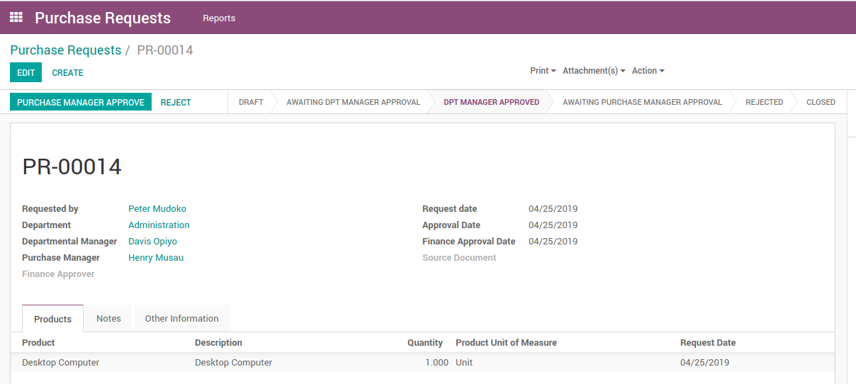
Purchase Manager Approval
The purchase manager clicks on ‘PURCHASE MANAGER APPROVE’

Slide 12
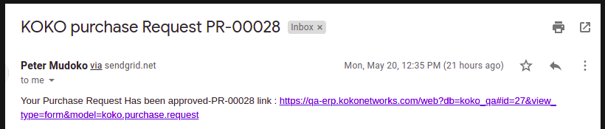
Notification to the Purchase Requestor
Once the PR has been fully authorised by HOD and the Purchase Manager the requestor will get an email notification to alert him/ her of the approval / rejection.

Slide 13
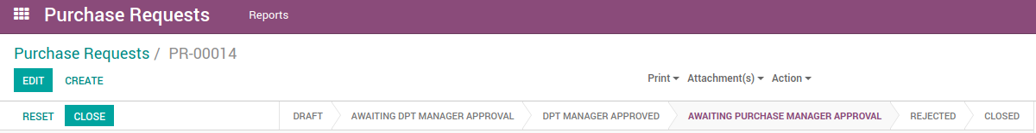
The purchase manager will click close

Slide 14
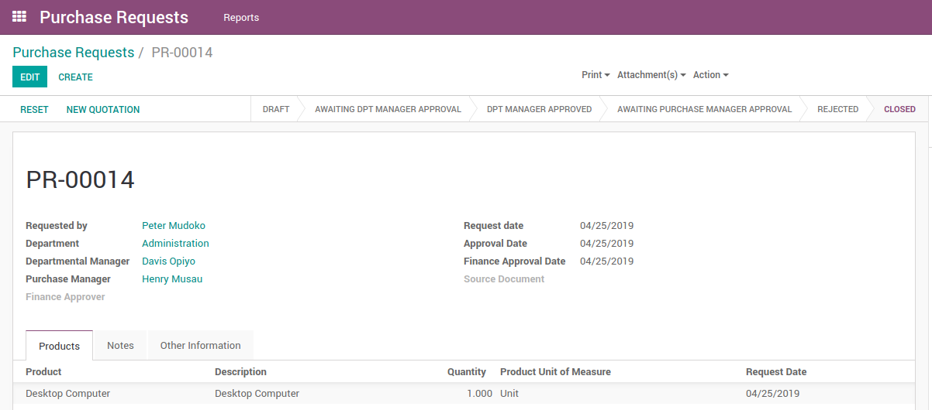
Once that is done, the ‘new quotation button’ will appear for an RFQ to be created

